Slide 1
CGF Forest Positive Coalition
Guidance on the Forest Positive Beef Roadmap
Version 1.0 - February 2023

Slide 2
About the CGF Forest Positive Coalition of Action
The CGF Forest Positive Coalition of Action (FPC) is comprised of member companies committed to moving efficiently and quickly towards a forest positive future and who understand the need to work collaboratively with multiple stakeholders.
The Coalition is focused on making progress through a combination of Coalition-wide Actions and delivering on commodity-specific roadmaps for palm oil, soy, pulp, paper and packaging (PPP), and beef.
The approach of the Coalition is based on a Theory of Change that builds on:​
Volumes sourced by members should be deforestation and conversion-free​
Suppliers implement forest positive commitments across their business​
Production landscapes transition to become forest positive

Slide 3
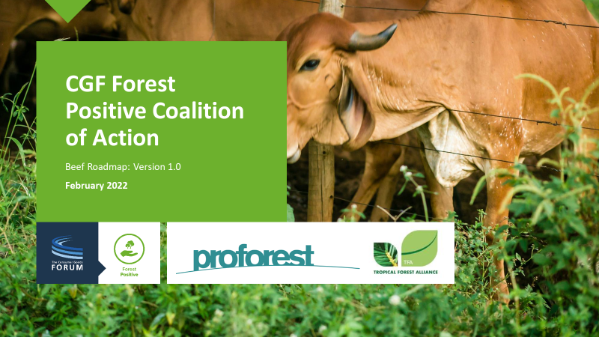
About the Forest Positive Beef Roadmap
The Forest Positive Beef Roadmap is made up of 5 elements:
Element 1: Own Supply Chain
Element 2: Suppliers & Meatpackers
Element 3: Monitoring and Response
Element 4: Landscape Engagement
Element 5: Transparency & Accountability
For each of these elements there are:
The commitments of Coalition members
Individual and collective actions to implement the commitments
Public information and KPIs for aligned reporting by Coalition members

Slide 4
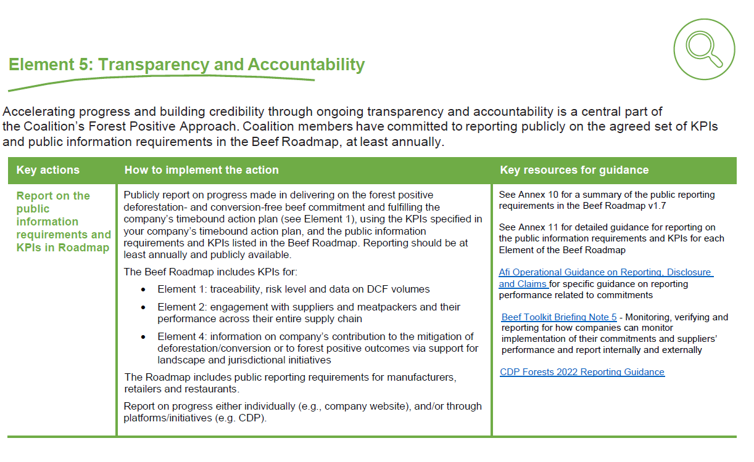
About the Guidance on the Forest Positive Beef Roadmap
The Forest Positive Beef Working Group published the Guidance on the Forest Positive Beef Roadmap (v1.0) in February 2023, which provides guidance on implementation across the five Roadmap Elements.
Each table includes key actions, how to implement the action and key resources for guidance.
Structure (one table per roadmap element):
Introduction and antitrust
Element 1: Own Supply Chain
Element 2: Suppliers & Meatpackers
Element 3: Monitoring and Response
Element 4: Engagement in Landscapes
Element 5: Transparency & Accountability
Annexes

Slide 5
Guidance on the Forest Positive Beef Roadmap
- Purpose
Purpose of Guidance:
Support on the implementation of Beef Roadmap: structured around the five Roadmap Elements
Action-oriented: key actions for companies to deliver on commitments in the Roadmap
Transparency on what members are doing and what the Coalition is working on
Note: The Guidance is a ‘living document’ and may include placeholders where a common approach or methodology still needs to be defined, either currently under discussion or to be developed. The direction of travel is disclosed and once a common approach is agreed, the document will be updated.
Does not include extensive detailed guidance, but points to existing resources companies can use

Slide 6
Guidance on the Forest Positive Beef Roadmap - Consultation
Consultation documents:
Introductory slide deck (this deck)
Guidance on the Forest Positive Beef Roadmap (v1.0)
Feedback template (word doc)
Action: If you have any comments, please fill in the Feedback template and send it over to CGFRoadmaps@proforest.net.
When reviewing, please consider the following questions:
Does the proposed approach work?
Any concerns with implementation of the approach?
Any additional or alternative suggestions/solutions?
Consultation timeline:
This is a living document and will be updated when relevant. Comments are welcome at any moment.

